Slide 1


dine & discover
A database for restaurant reviews & reservations.
April 15, 2024

Slide 2




dine & discover
Top Recommended
Write a Review
Sign in
Table of Contents
1
Business Scenario Overview
Mission Statement & Objectives
ERD
Relational Schema Overview
2 Challenging Queries
Learning Experience
1.1 User Interface Inspiration
1.2 User Interface Mockup
2
3
4
5
6

Slide 3

dine & discover
1
Business Scenario Overview

Slide 4
dine & discover
Top Recommended
Write a Review
Sign in
Business Overview
Dine & Discover is a restaurant review platform designed to enhance the way people discover and explore new dining options in their area. Our platform is dedicated to providing users with a seamless and immersive journey through the diverse landscape of dining options, offering a rich tapestry of culinary experiences waiting to be discovered and savoured.
Business Process
Similarly to Yelp, users can create accounts to track restaurants they have been to, discover new restaurants, and write reviews to share their culinary experiences. Additionally, features from OpenTable are integrated as well to enhance the overall user experience in terms of booking restaurants, which is less of a focus for Yelp. This seamless process ensures that users can effortlessly immerse themselves in the vibrant world of dining discovery, fostering a community-driven platform that celebrates the joy of culinary exploration.
Business Scenario Overview
Project Scope

Slide 5
dine & discover
Top Recommended
Write a Review
Sign in
Features & Functionalities
The platform contains a comprehensive database of restaurants within a certain area, providing information on location, cuisine types, ratings, etc. as well as offering the possibility to book a reservation directly on the platform. As for users, they can easily create an account to track their reservations and reviews, making Dine & Discover the ultimate all-in-one database for foodies. Overall, the business aims to help and support local restaurants by increasing their visibility on this review platform and creating a sense of community between the restaurants including owners, managers, etc. and general users seeking new dining recommendations, the two primary users of the platforms.
Business Scenario Overview
Project Scope

Slide 6
dine & discover
Top Recommended
Write a Review
Sign in
Business Rules
Only users who have accounts may leave reviews.
All reviews must comply with community guidelines as well as only contain appropriate language.
Restaurants must meet certain criteria to be listed on the platform including maintaining health and hygiene standards and practices, cultural authenticity, etc.
Restaurants are allowed to remain on the platform, even if they receive no reviews.
Business Scenario Overview
Project Scope

Slide 7
dine & discover
1.1
User Interface Inspiration

Slide 8
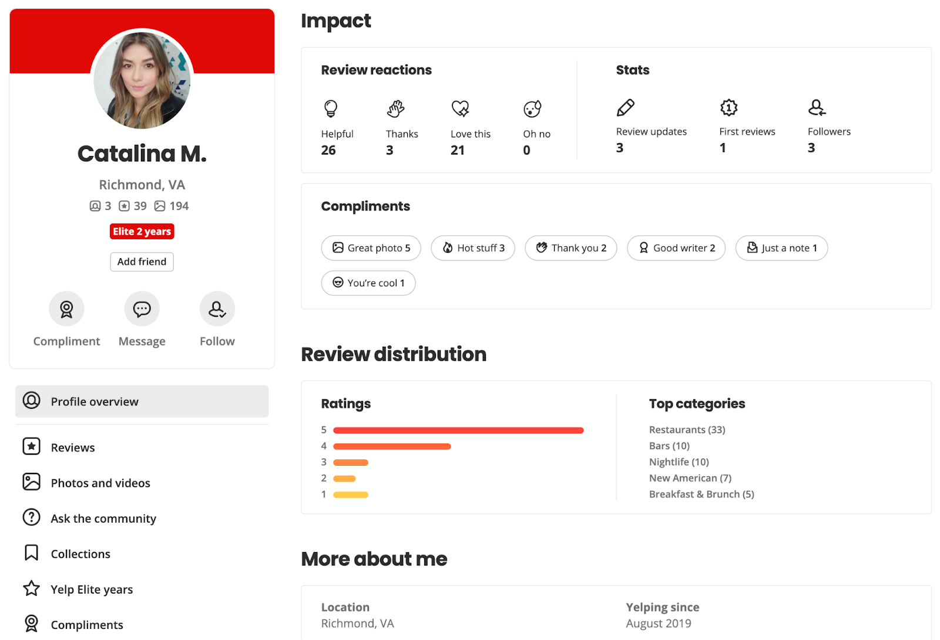
dine & discover
Top Recommended
Write a Review
Sign in
Sample User Profile

Slide 9
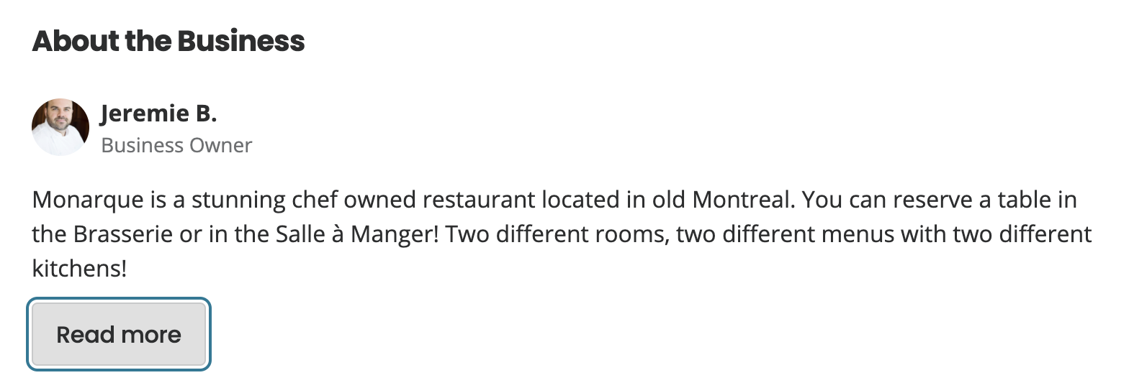
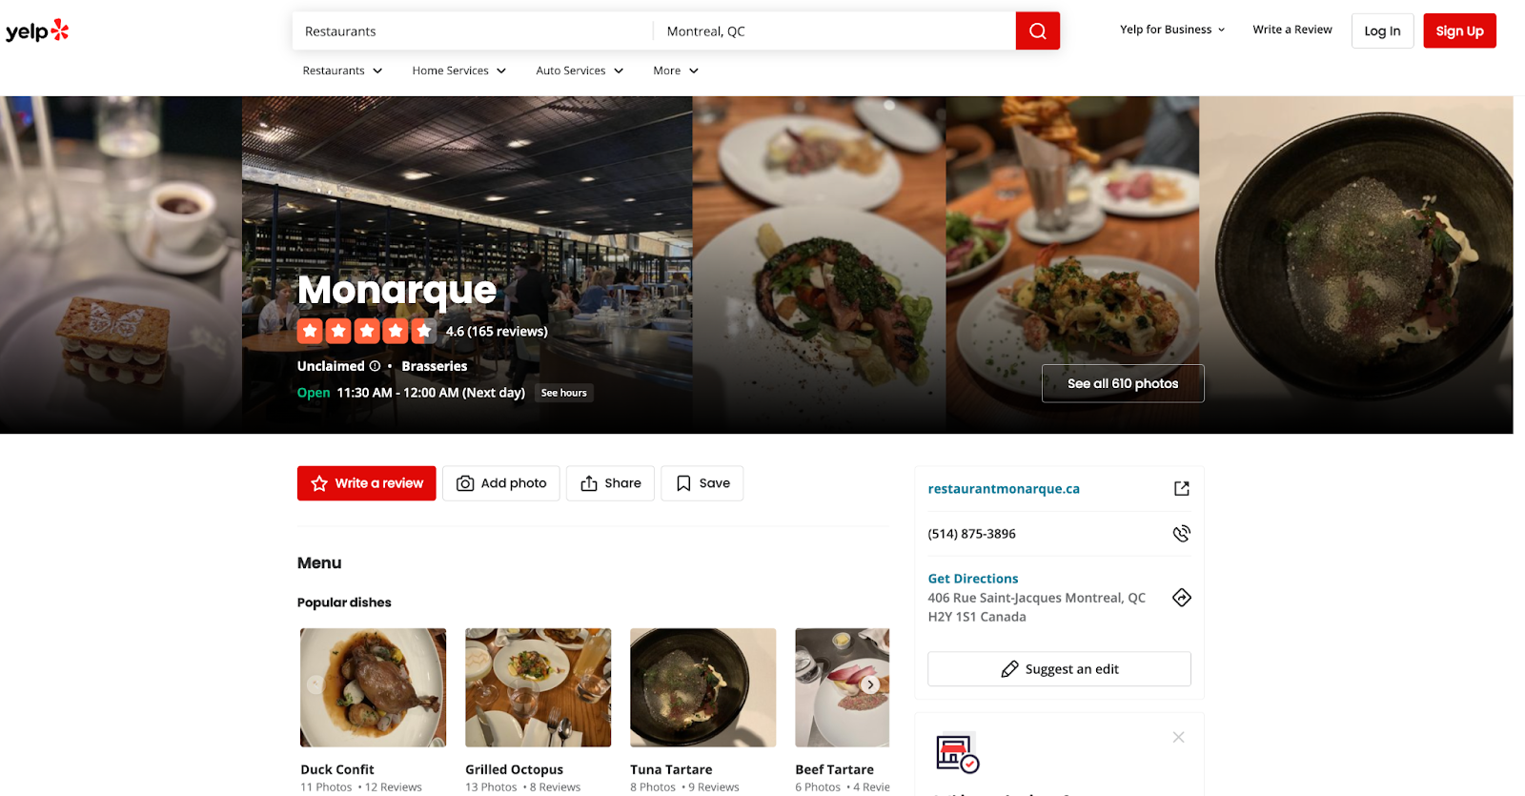
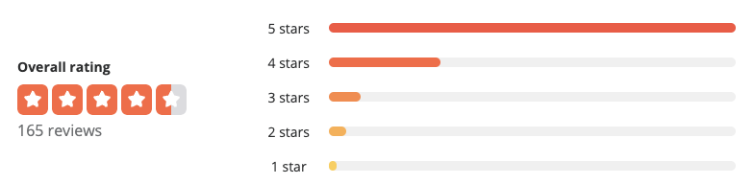
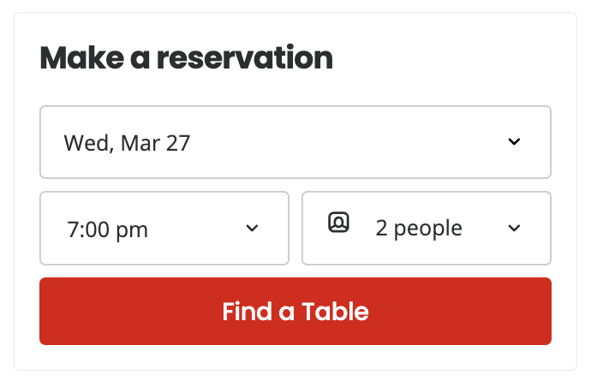
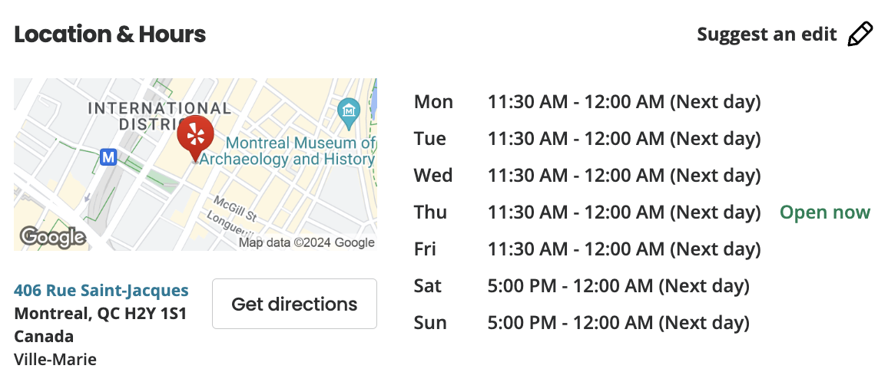
dine & discover
Top Recommended
Write a Review
Sign in
Sample Restaurant Profile

Slide 10
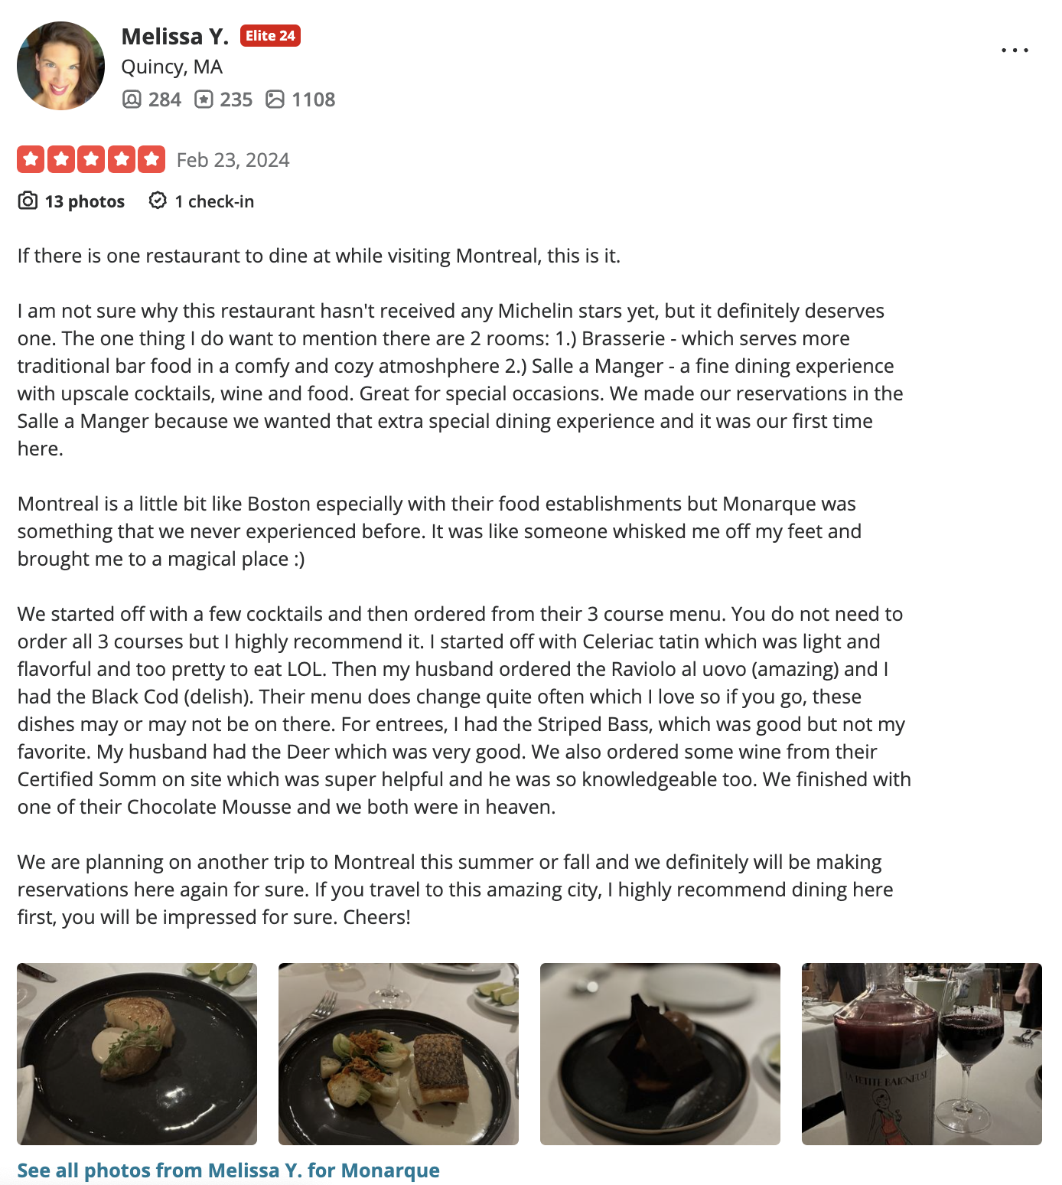
dine & discover
Top Recommended
Write a Review
Sign in
Sample Restaurant Review

Slide 11
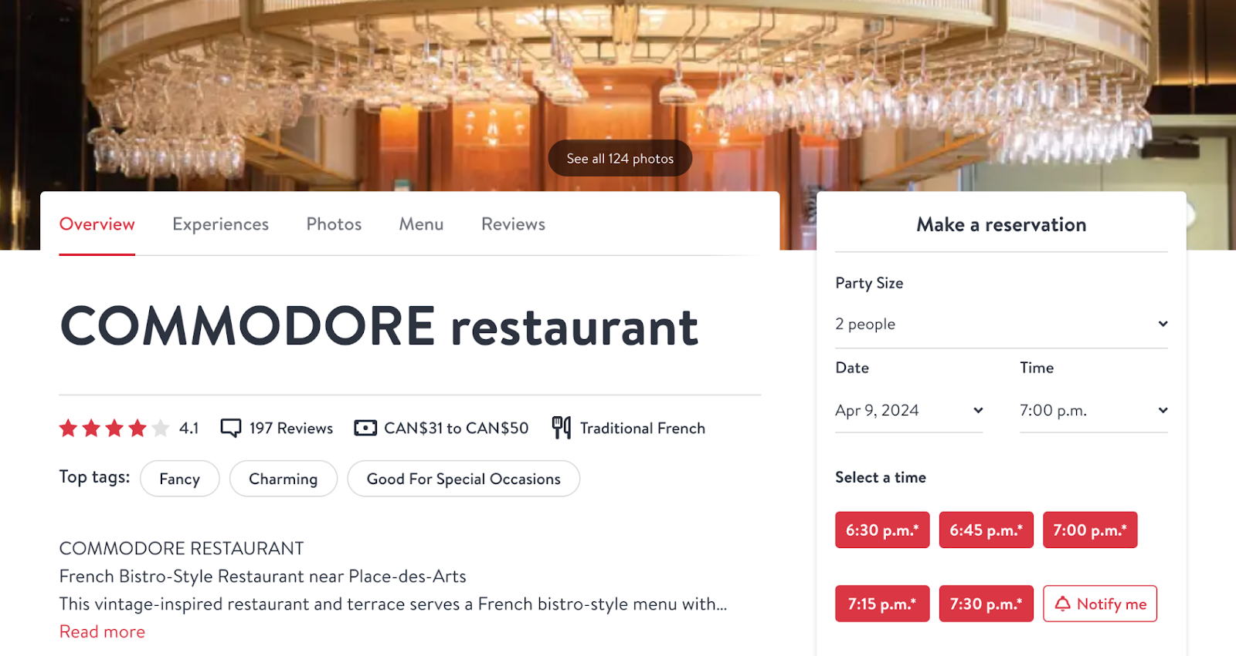
dine & discover
Top Recommended
Write a Review
Sign in
Sample Reservation Booking

Slide 12
dine & discover
1.2
User Interface Mockup

Slide 13









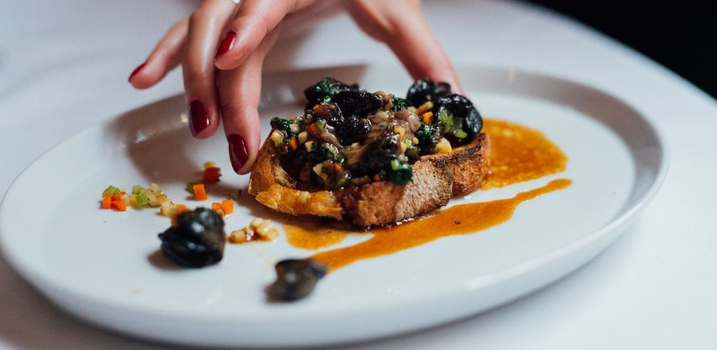
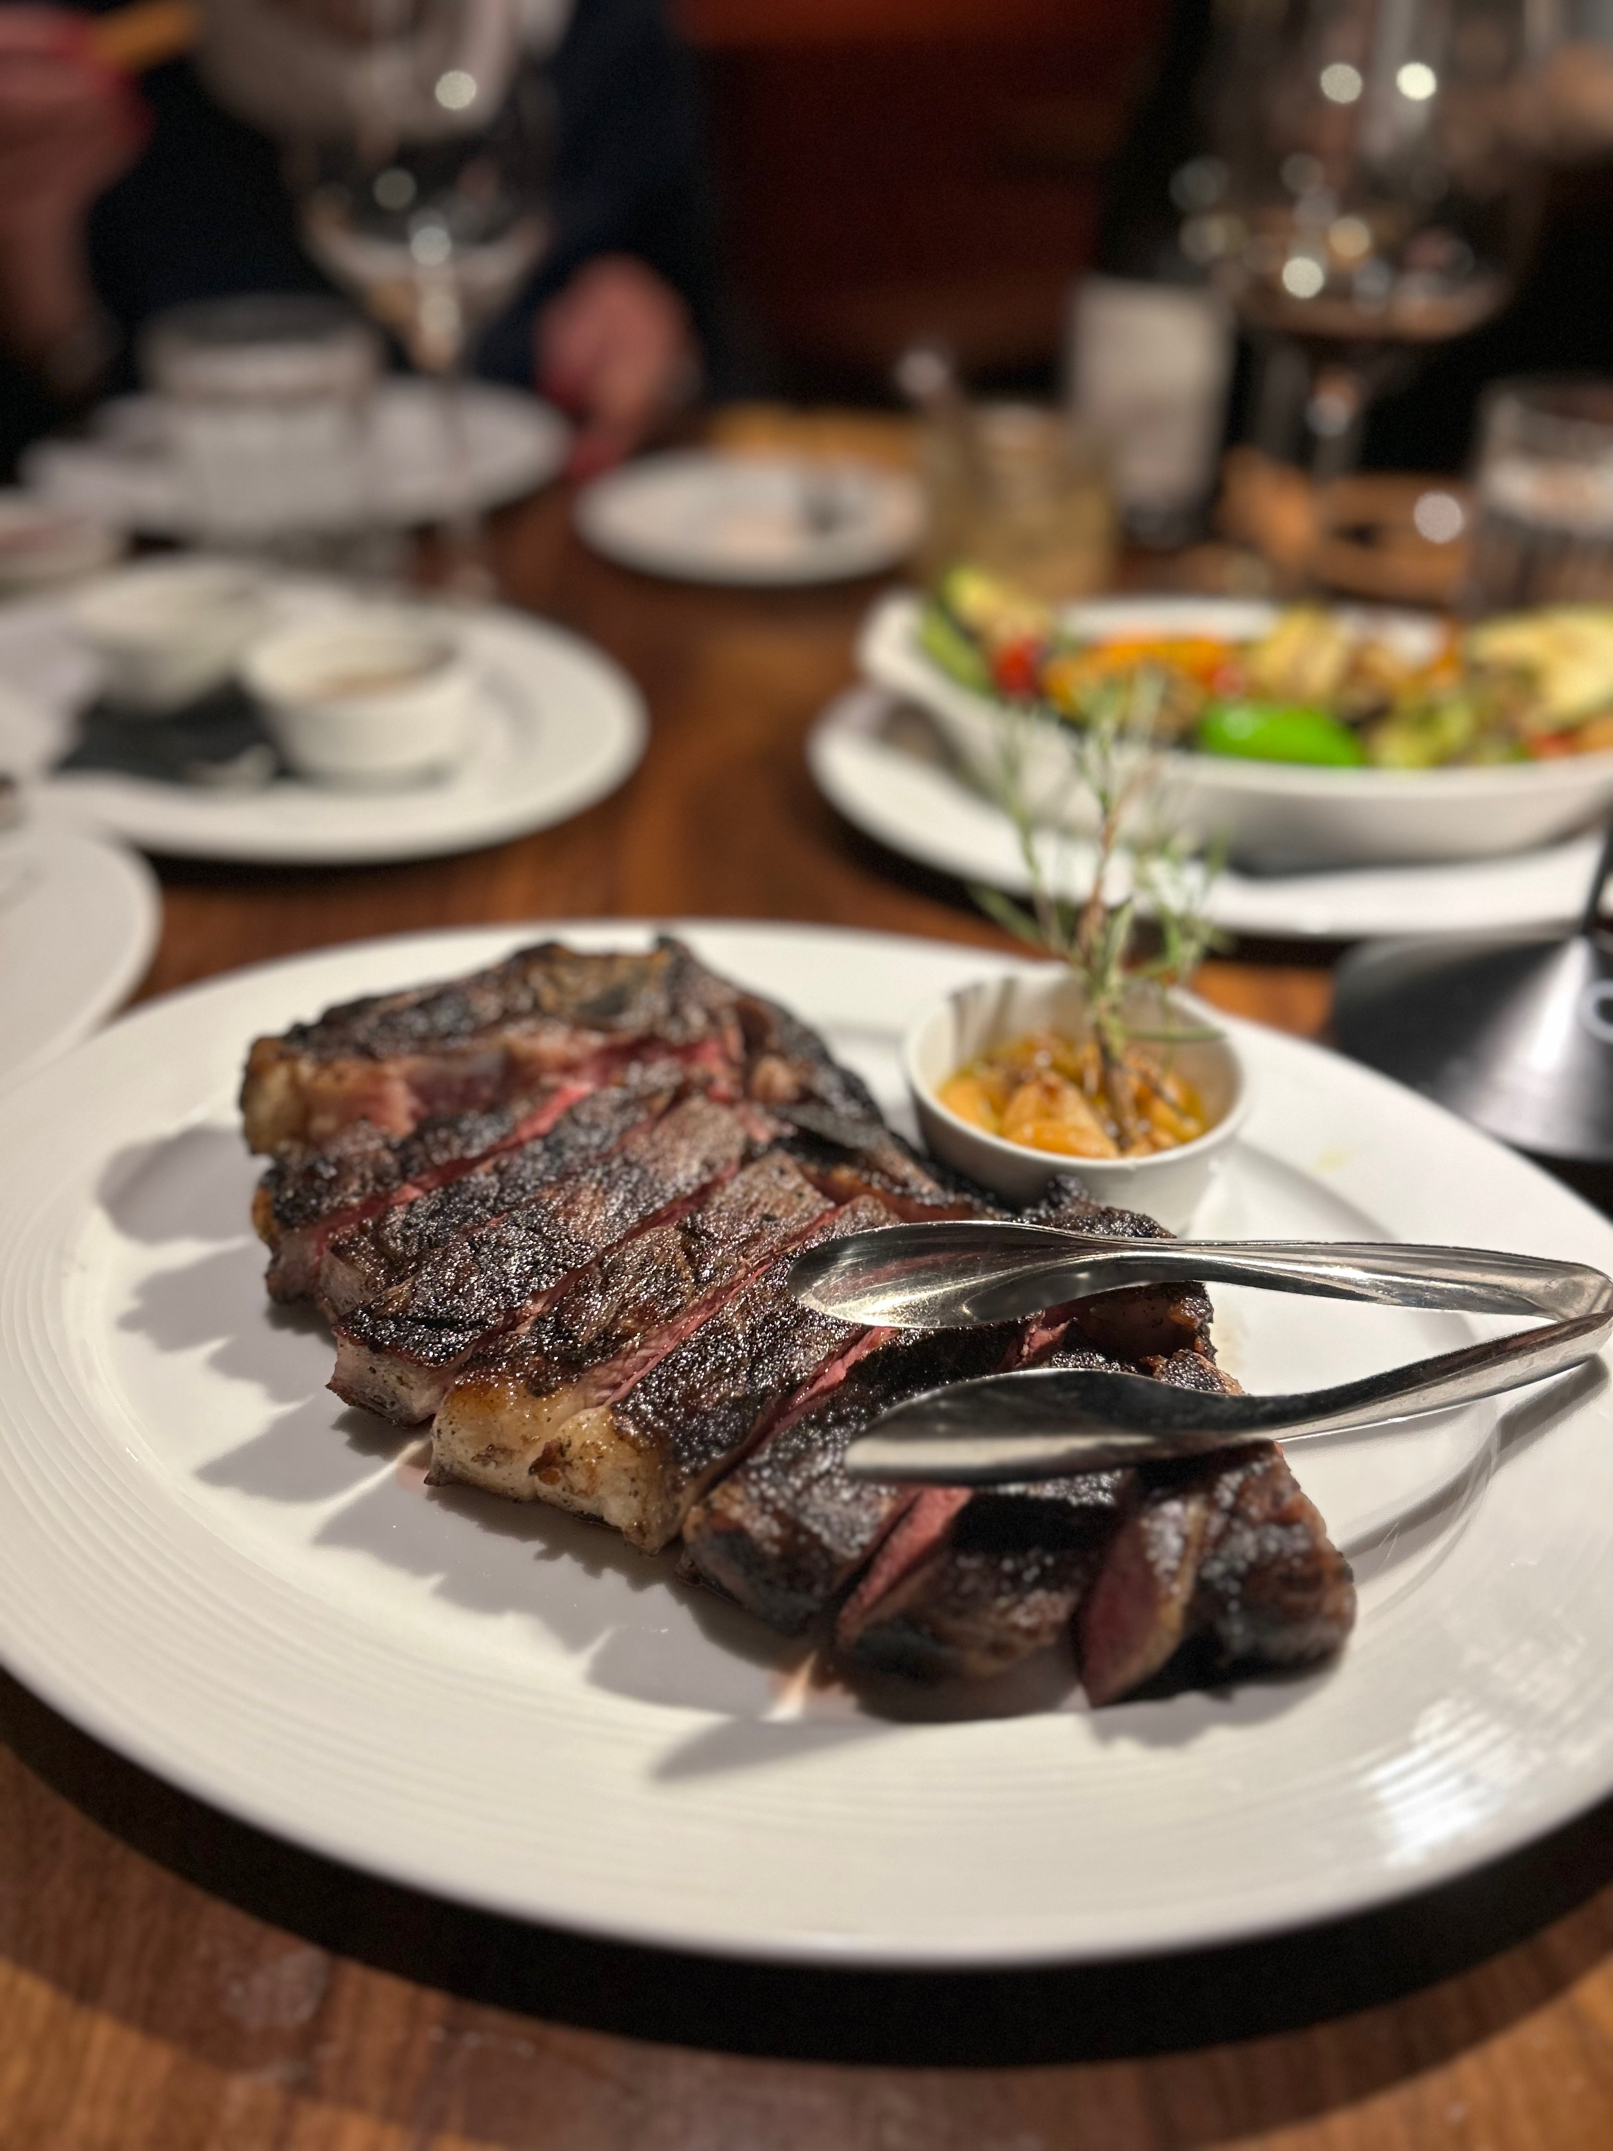
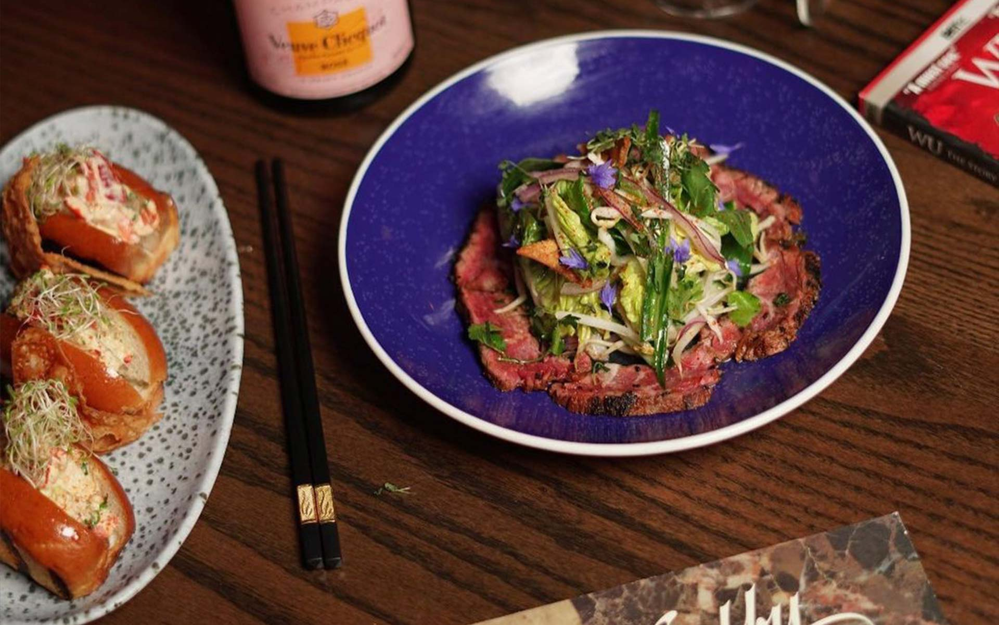

dine & discover
Top Recommended
Write a Review
Sign in
Find a table, discover a new favorite.
April 15, 2024
5:30 p.m.
4 people
Location, Restaurant, or Cuisine
Let’s go
It looks like you’re in Montreal. Not correct?
Get current location
Recent Activity
Nearby Friends Following
Cara-Li Farrell
1 hour ago
Olivia Hoang
2 hours ago
Harveen Sivia
3 hours ago
Faye Wu
4 hours ago
Monarque
Moishes Montreal
The Farsides
India Rosa

Slide 14
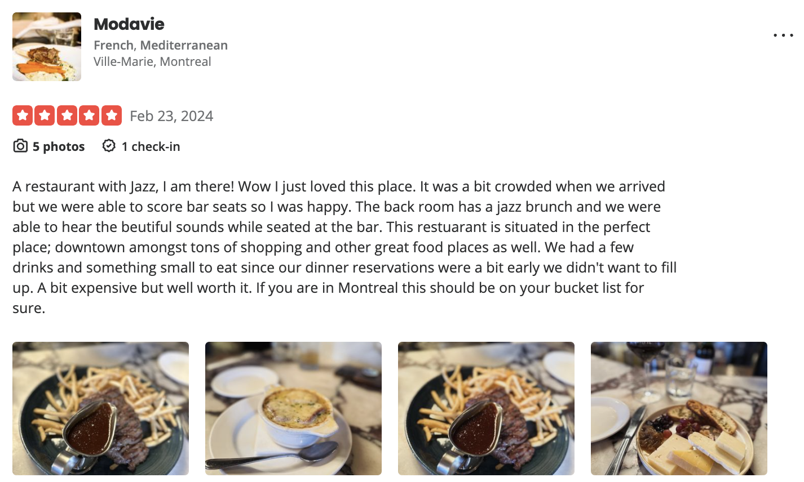

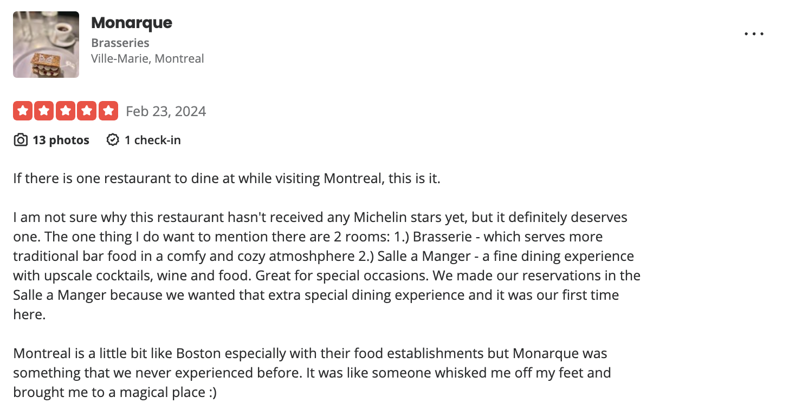
dine & discover
Top Recommended
Write a Review
Hello, Cara-Li!
Reviews
Hello Cara-Li! Ready to Dine & Discover?
Cara-Li Farrell
Montreal, Canada
User since January 1, 2024
See all photos from Cara-Li F. for Modavie
26 followers
26 followers
Olivia Hoang
Harveen Sivia
Faye Wu
John MacDonald
Jane Doe
5 like this

Slide 15

dine & discover
Mission Statement & Objectives
2

Slide 16
dine & discover
Top Recommended
Write a Review
Sign in
The purpose of the Dine & Discovery database system is to curate and manage the data that is used and generated by customers for discovering, evaluating, and sharing dining experiences. The platform aims to foster collaboration and information sharing amongst users and restaurant owners to enhance engagement within the dining community.
Mission Statement
Objectives

Slide 17




dine & discover
Top Recommended
Write a Review
Sign in
Maintain (enter, update, and delete) data on…
Perform searches on…
Track the status of…
To report on…
Addresses
Reservations
Addresses
Reservations
Reservations
Users
Addresses
Reservations
Restaurants
Users
Restaurants
Users
Reviews
Restaurants
Restaurants
Users
Reviews
Likes
Reviews
Likes
Comments
Reviews
Likes
Photos
Comments
Photos
Comments
Photos
Comments
Categories
Categories
Categories
Mission Statement
Objectives

Slide 18

dine & discover
3
ERD

Slide 19
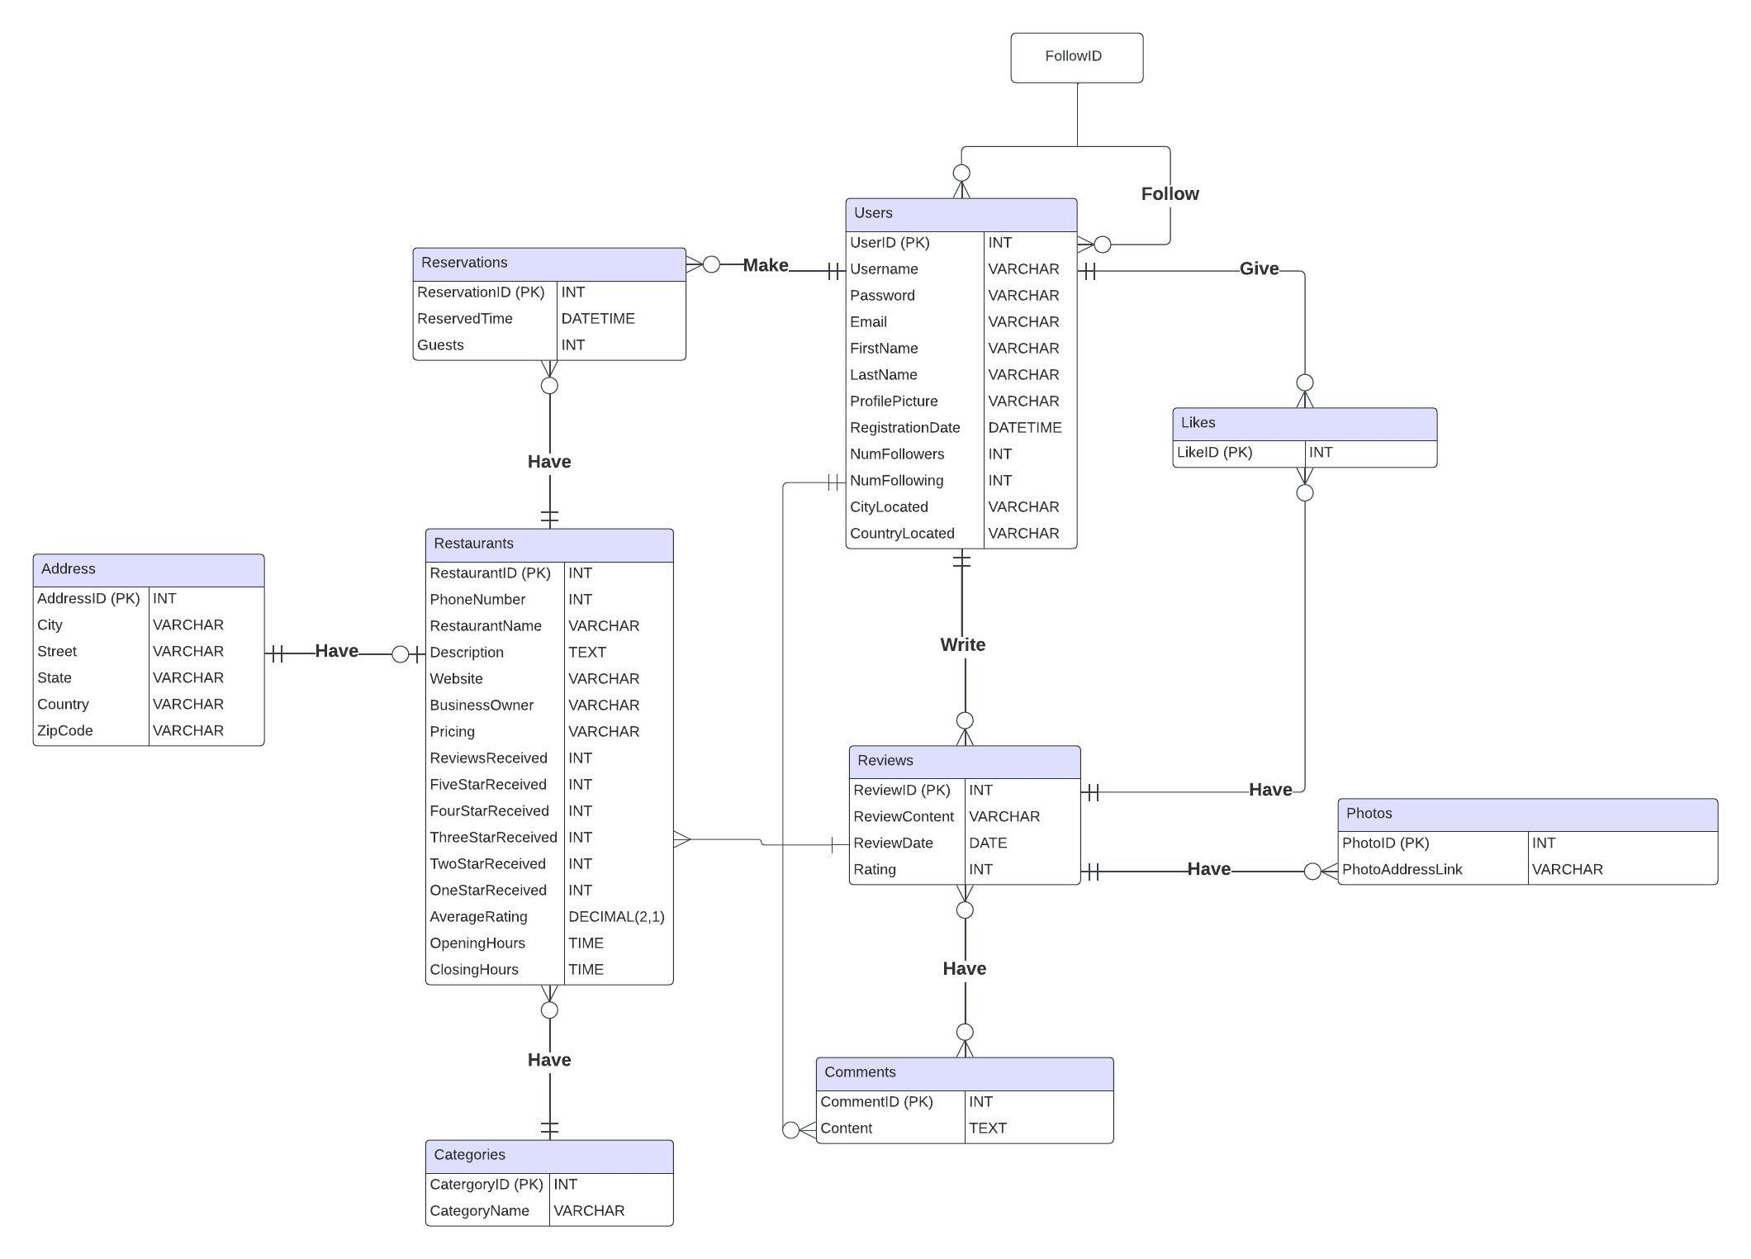
dine & discover
Top Recommended
Write a Review
Sign in

Slide 20

dine & discover
4
Relational Schema Overview

Slide 21
dine & discover
Top Recommended
Write a Review
Sign in
Users(UserID, Username, Password, Email, FirstName, LastName, ProfilePicture, RegistrationDate, NumFollowers, NumFollowing, CityLocated, CountryLocated)
PK: UserID
Follow(FollowID, UserID)
PK: FollowID
FK: UserID References Users(UserID)
Reviews(ReviewID, ReviewContent, ReviewDate, Rating, PhotoID, UserID)
PK: ReviewID
FK: PhotoID References Photos(PhotoID)
FK: UserID References Users(UserID)
Comments(CommentID, Content, ReviewID, UserID)
PK: CommentID
FK: ReviewID References Reviews(ReviewID)
FK: UserID References Users(UserID)
Likes(LikeID, ReviewID, UserID)
PK: LikeID
FK: ReviewID References Reviews(ReviewID)
FK: UserID References Users(UserID)

Slide 22
dine & discover
Top Recommended
Write a Review
Sign in
Photos(PhotoID, PhotoAddressLink, ReviewID)
PK: PhotoID
FK: ReviewID References Reviews(ReviewID)
Reservations(ReservationID, ReservedTime, Guests, RestaurantID, UserID)
PK: ReservationID
FK: RestaurantID References Restaurants(RestaurantID)
FK: UserID References Users(UserID)
Restaurants(RestaurantID, PhoneNumber, RestaurantName, Description, Website, BusinessOwner, Pricing, ReviewReceived, FiveStarReceived, FourStarReceived, ThreeStarReceived, TwoStarReceived, OneStarReceived, AverageRating, OpeningHours, ClosingHours, AddressID, CategoryID)
PK: RestaurantID
FK: AddressID References Address(AddressID)
FK: CategoryID References Categories(CategoryID)
Categories(CategoryID, CategoryName)
PK: CategoryID
Address(AddressID, City, Street, State, Country, ZipCode)
PK: AddressID

Slide 23

dine & discover
5
2 Challenging Queries

Slide 24
dine & discover
Top Recommended
Write a Review
Sign in
SELECT R.RestaurantID, R.RestaurantName, RV.ReviewID, RV.ReviewContent, RV.Rating, RV.UserID, MAX(L.TotalLikes) AS MaxLikes
FROM Restaurants R
JOIN Reviews RV ON R.RestaurantID = RV.RestaurantID
JOIN (
SELECT ReviewID, COUNT(*) AS TotalLikes
FROM Likes
GROUP BY ReviewID
) L ON RV.ReviewID = L.ReviewID
GROUP BY R.RestaurantID, R.RestaurantName, RV.ReviewID, RV.ReviewContent, RV.Rating, RV.UserID
HAVING MAX(L.TotalLikes) = (
SELECT MAX(L2.TotalLikes) AS MaxLikes
FROM Restaurants R2
JOIN Reviews RV2 ON R2.RestaurantID = RV2.RestaurantID
JOIN (
SELECT ReviewID, COUNT(*) AS TotalLikes
FROM Likes
GROUP BY ReviewID
) L2 ON RV2.ReviewID = L2.ReviewID
WHERE R2.RestaurantID = R.RestaurantID
)
ORDER BY R.RestaurantID, MaxLikes DESC;
Purpose of Query #4
Find the review(s) with the most number of likes for each restaurant.
How it Works
This query joins the Restaurants, Reviews, and Likes tables, calculating the total number of likes for each review, and then selecting the review(s) with the maximum number of likes for each restaurant.
Managerial Insights
This query helps identify influential customer reviews, understand customer preferences, enhance reputation management, encourage user engagement, and improve marketing strategies based on highly-liked reviews for each restaurant.
Query #1
Query #2

Slide 25
dine & discover
Top Recommended
Write a Review
Sign in
SELECT
a.Country AS CountryName,
r.RestaurantName AS TopRestaurant,
COUNT(*) AS ReservationCount
FROM
Reservations res
JOIN
Restaurants r ON res.RestaurantID = r.RestaurantID
JOIN
Address a ON r.AddressID = a.AddressID
GROUP BY
a.Country, r.RestaurantID
HAVING
COUNT(*) = (
SELECT
COUNT(*)
FROM
Reservations res_inner
JOIN
Restaurants r_inner ON res_inner.RestaurantID = r_inner.RestaurantID
JOIN
Address a_inner ON r_inner.AddressID = a_inner.AddressID
WHERE
a_inner.Country = a.Country
GROUP BY
r_inner.RestaurantID
ORDER BY
COUNT(*) DESC
LIMIT 1
);
Purpose of Query #17
Find the top 1 restaurant with the most reservations for each country.
How it Works
This query joins Reservation, Restaurant, and Address tables, grouping the data by country and restaurant, and selecting restaurants where the count of reservations matches the highest count of reservations for that country.
Managerial Insights
This query helps with making strategic decisions regarding resource allocation and market targeting for the most reserved restaurants per country.
Query #1
Query #2

Slide 26

dine & discover
6
Learning Experience

Slide 27
dine & discover
Top Recommended
Write a Review
Sign in
Challenges
Choosing which characteristics to incorporate to achieve a balance between complexity and the capability to efficiently build and utilize the database
Communicating and working collectively on every step of the process
Dividing the work equally amongst all team members
Ensuring data consistency and integrity across the database, especially when multiple team members are involved in data entry and management
Learnings
Overseeing the entire database creation process
Learning how basic web applications are created at the most fundamental level
Creating a complete and well-structured ERD with accurate relations between all tables and necessary attributes from the application
Learning how businesses can utilize SQL for decision-making processes at the operational level

Slide 28
Thank You!

